Slide 1


Tree (Part 1)

Slide 2
Basics
A tree T is a finite, non-empty set of nodes, T = {r} ⋃ T₁ ⋃ T₂ ⋃ … ⋃ Tn,
with the following properties:
A designated node of the singleton, r, is called the root of the tree.
The remaining nodes are partitioned into n ≥ 0 subsets T1, T2, …, Tn, each of which is a tree.

Slide 3
Definition
Tree
undirected graph
any two nodes are connected by exactly one edge
no loop
Why are trees in computer science generally drawn upside down?
https://www.quora.com/Why-are-trees-in-computer-science-generally-drawn-upside-down-from-how-trees-are-in-real-life

Slide 4
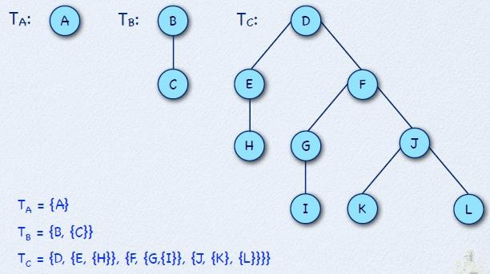
Tree Examples

Slide 5
Parent and Children
The root node r of tree T is the parent of all the roots r_{i} of the subtrees T_{i}, 1 < i ≤ n.
Each root r_{i} of subtree T_{i} of tree T is called a child of r.

Slide 6
Degree
The degree of a node is the number of subtrees associated with that node.
A node of degree zero has no subtrees. Such a node is called a leaf.
Two roots r_{i} and r_{j} of distinct subtrees T_{i} and T_{j} with the same parent in tree T are called siblings.

Slide 7
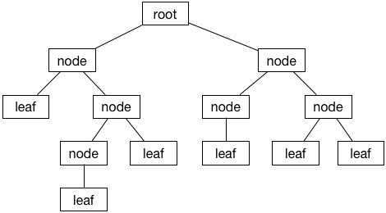
Structure of a Tree
Figure from: https://www.raywenderlich.com/990-swift-algorithm-club-swift-binary-search-tree-data-structure

Slide 8
Path and Path Length
Given a tree T containing the set of nodes R, a path in T is defined as a non-empty sequence of nodes.
P = {r₁, r₂, …, r_{k}}
where r_{i} ∈ R, for 1 ≤ i ≤ k such that the i^{th} node in the sequence, r_{i}, is the parent of the (i+1)th node in the sequence r_{i+1}.
The length of path P is k-1.
∈ symbol means “is an element of”

Slide 9
Depth, Height and Level
The depth of a node is the number of edges from the node to the tree's root node.
A root node will have a depth of 0.
The height of a node is the number of edges on the longest path from the node to a leaf.
Height of tree –The height of a tree is the number of edges on the longest downward path between the root and a leaf.
A leaf node will have a height of 0.
The level of a node is defined by 1 + the number of connections between the node and the root.
i.e. level = depth+1

Slide 10
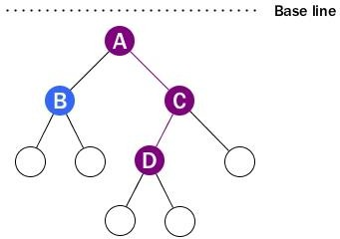
Example
The height of the tree is 3
The height of Node C is 2 (count from bottom)
The depth of Node D is 2 (count from top)

Slide 11
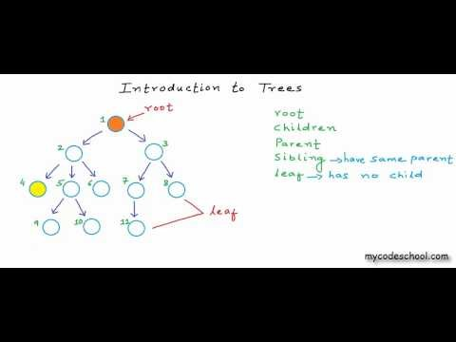
Introduction to Trees
URL: https://www.youtube.com/watch?v=qH6yxkw0u78

Slide 12
Nodes With the Same Degree
The general case allows each node in a tree to have a different degree (The number of subtrees of a node is called the degree of the node). We now consider a variant of trees in which each node has the same degree.
Unfortunately, it is not possible to construct a tree that has a finite number of nodes, which all have the same degree N, except the trivial case N = 0.
We need a special notion, called empty tree, to realize trees in which all nodes have the same degree.

Slide 13
N-ary tree
An N-ary tree T, N ≥ 1, is a finite set of nodes with one of the following properties:
Either the set is empty, T = ∅, or
The set consists of a root, R, and exactly N distinct
N-ary trees, That is, the remaining nodes are partitioned into N ≥ 1 subsets, T1, T2, …, TN, each of which is an N-ary tree such that
T = {R, T1, T2, …, TN}.

Slide 14
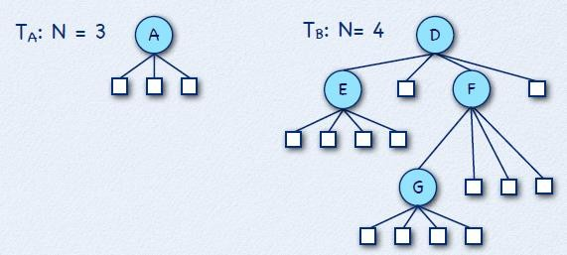
N-ary Tree Examples

Slide 15
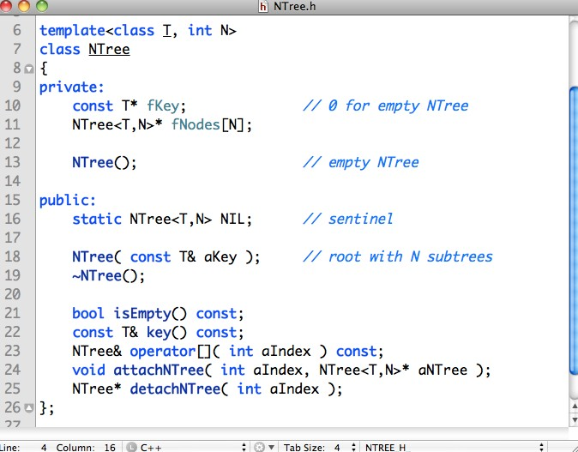
Ntree Class

Slide 16
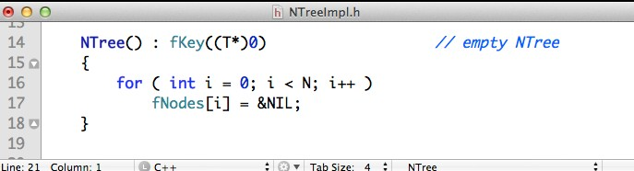
The Private Empty NTree Constructor
We use (T*)0), the null pointer, to initialize the fKey with a suitable value of type pointer to T.
Each subtree-node is set to the location of NIL, the sentinel node for NTree.
This constructor is only used to set up the sentinel for NTree.

Slide 17
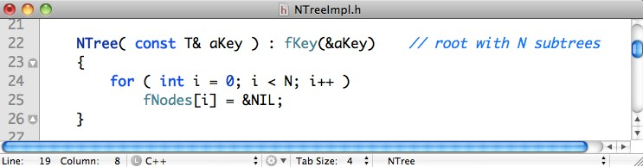
The Public NTree Constructor
We store the address of the reference aKey in fKey.
Each child node in a non-empty NTree leaf node is set to the location of NIL, the sentinel node for NTree.
In computer programming, a sentinel node is a specifically designated node used with linked lists and trees as a traversal path terminator. This type of node does not hold or reference any data managed by the data structure.

Slide 18
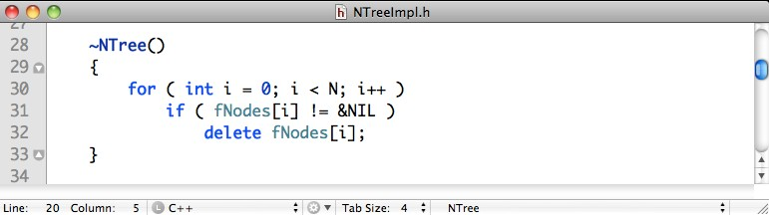
The NTree Destructor
In the destructor of NTree only non-sentinel nodes are destroyed.

Slide 19
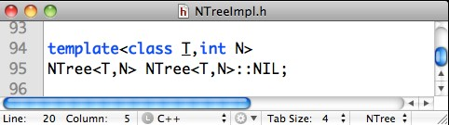
The NTree Sentinel
Static instance variables, like the NTree sentinel NIL, need to be initialized outside the class definition.
Here, NIL is initialized using the private default constructor.
The scope of NIL is Ntree. It means that all members of Ntree are available, including the private constructor to initialize NIL.

Slide 20
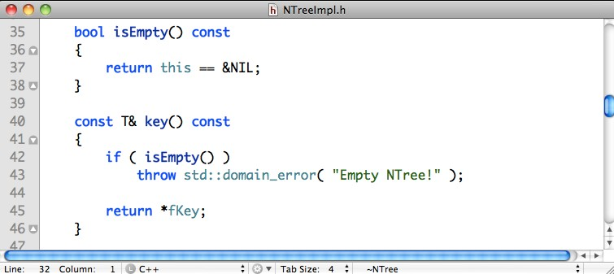
The NTree Auxiliaries

Slide 21
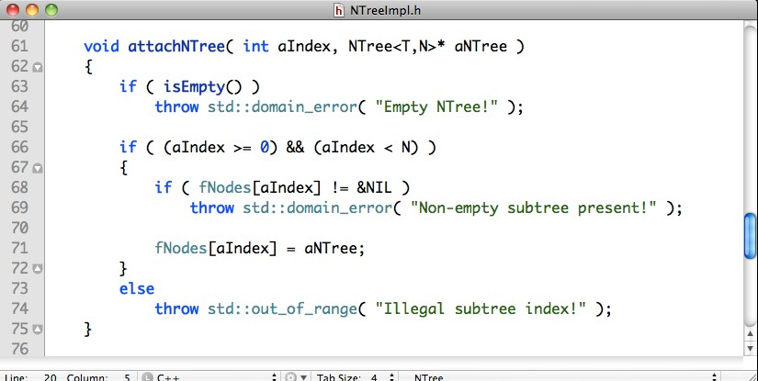
Attaching a New Subtree

Slide 22
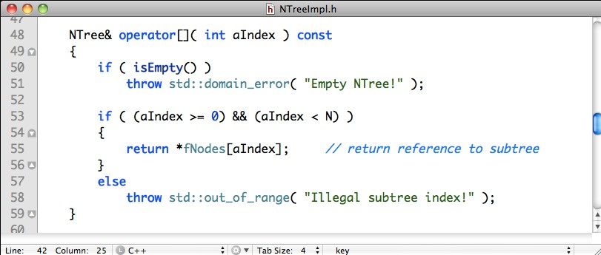
Accessing a Subtree (Operator [])
We return a reference to the subtree rather than a pointer. This way, we prevent accidental manipulations outside the tree structure.

Slide 23
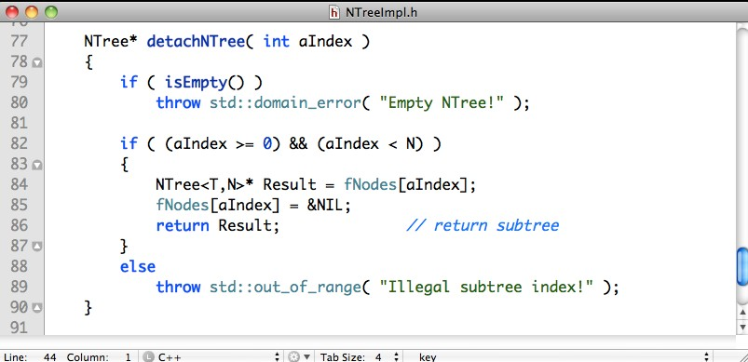
Removing a Subtree

Slide 24
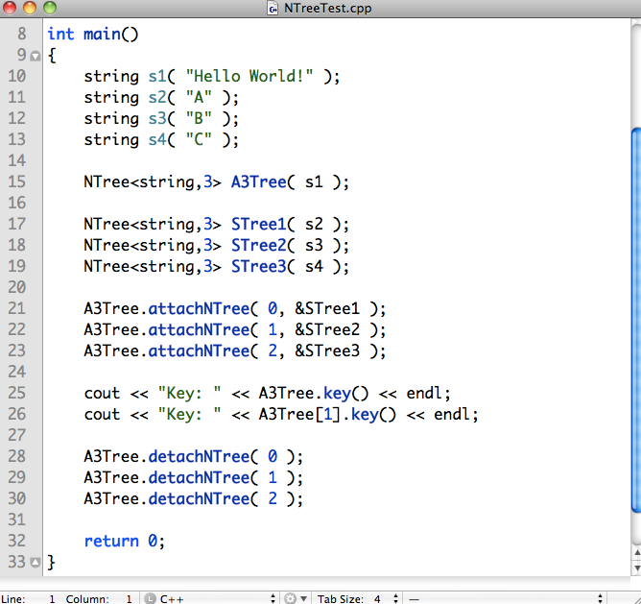
A NTree Example

Slide 25
Binary Trees (2-ary Trees)
Definition: A Binary Tree is a Tree in which each node has a degree of at most 2.
A binary tree T is a finite set of nodes with one of the following properties:
Either the set is empty, T = ∅, or
The set consists of a root, R, and exactly 2 distinct binary trees TL and TR, T = {R, TL, TR}.
The tree TL is called the left subtree of T and the tree TR is called the right subtree of T.

Slide 26
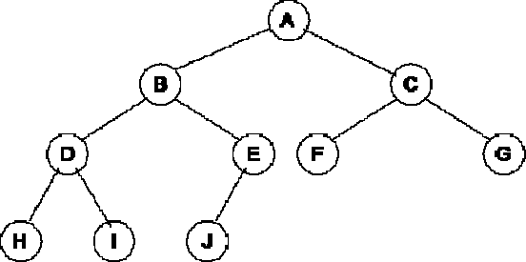
Example : Binary Tree

Slide 27
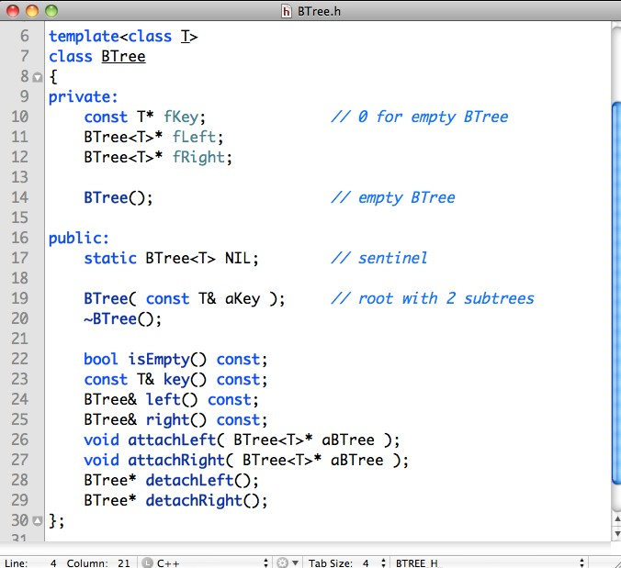
BTree Class

Slide 28
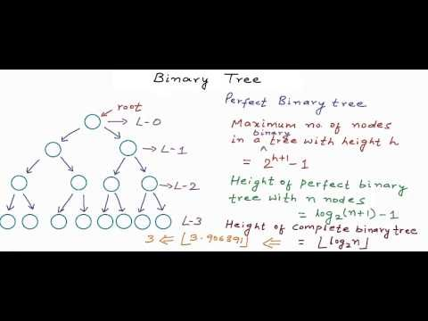
Binary Tree
URL: https://www.youtube.com/watch?v=H5JubkIy_p8

Slide 29
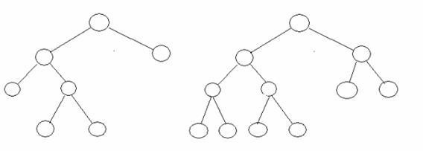
More on binary tree
Full Binary tree:
Every node should have exactly 2 nodes except the leaves. It is also called as Strict Binary Tree or Proper Binary Tree.
Every node must have either 0 or 2 children.

Slide 30
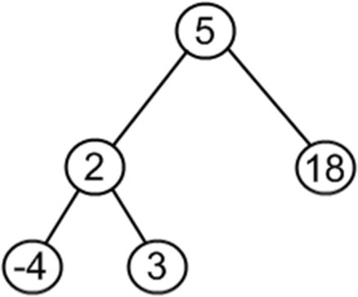

More on binary tree
Complete Binary Tree:
It is a binary tree in which every level (except possibly the last) is completely filled, and all nodes are as far left as possible.

Slide 31
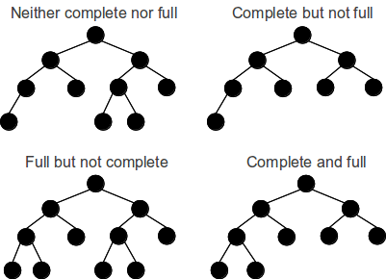
More on binary tree

Slide 32
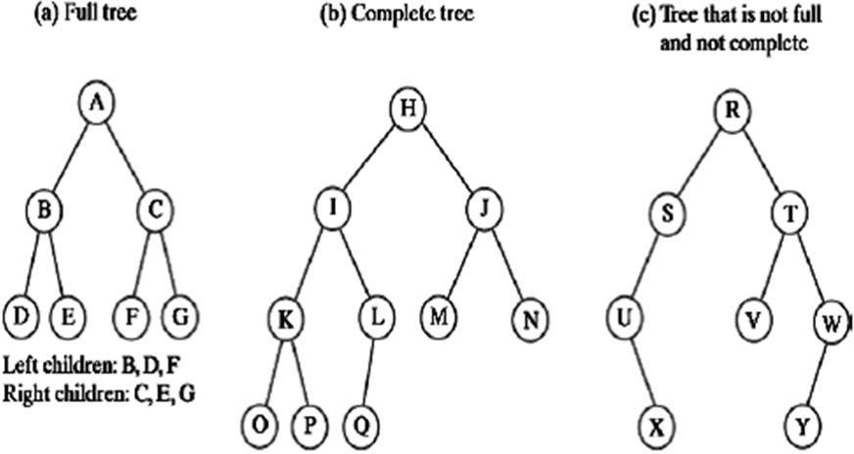
More on binary tree

Slide 33

Binary Search Tree
URL: https://www.youtube.com/watch?v=COZK7NATh4k

Slide 34
Tree Traversal
Many different algorithms for manipulating trees exist, but these algorithms have in common that they systematically visit all the nodes in the tree.
There are essentially two methods for visiting all nodes in a tree:
Depth-first traversal (Depth First Search, DFS),
Breadth-first traversal (Breadth First Search, BFS)

Slide 35
Depth-first Traversal
Pre-order traversal:
Visit the root first; and then
Do a preorder traversal of each of the subtrees of the root one-by-one in the order
given (from left to right).
Post-order traversal:
Do a postorder traversal of each of the subtrees of the root one-by-one in the order given (from left to right); and
then visit the root.
In-order traversal:
Traverse the left subtree; and then
Visit the root; and then
Traverse the right subtree.

Slide 36
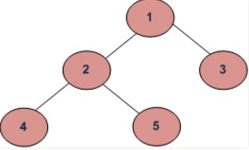
Example of Depth-first Traversal
(a) Preorder (Root, Left, Right) : 1 2 4 5 3
(b) Postorder (Left, Right, Root) : 4 5 2 3 1
(c) Inorder (Left, Root, Right) : 4 2 5 1 3

Slide 37
Breadth-first Traversal
Breadth-first traversal visits the nodes of a tree in the order of their depth (from left to right).
BFS: 1 2 3 4 5

Slide 38
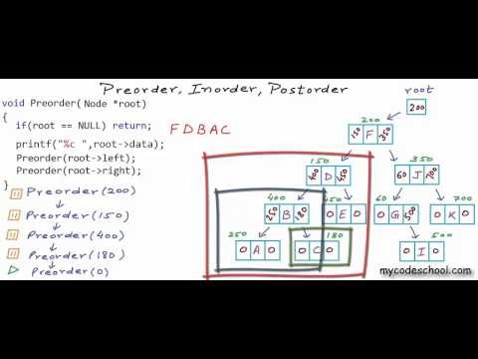
DFS: Preorder, Inorder and Postorder
Note: Slight mistake for Inorder example, there is no H in the actual answer.
URL: https://www.youtube.com/watch?v=gm8DUJJhmY4

Slide 39
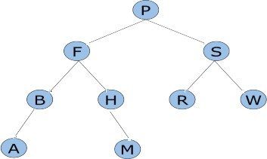
Exercise
Write the pre-order, in-order, post-order traversal of the following binary tree:
Is the binary tree complete or full?

Slide 40

Tricks for Preorder, Inorder and Postorder
Note: The video is in Hindi but the tricks for solving are great.
URL: https://www.youtube.com/watch?v=gm8DUJJhmY4

Slide 41
Exercise (Answers)
Pre-order Traversal (Root, Left, Right):
P, F, B, A, H, M, S, R, W

Slide 42
Exercise (Answers)
In-order Traversal (Left, Root, Right):
A, B, F, H, M, P, R, S, W

Slide 43
Exercise (Answers)
Post-order Traversal (Left, Right, Root):
A, B, M, H, F, R, W, S, P

Slide 44
Exercise (Answers)
The binary tree is not complete and not full.
It is not complete as some of the nodes have 1 leaf. In a complete binary tree, each nodes much have 0 or 2 children.
It is not full as not all nodes are as far left as possible.

Slide 45
End of Tree (Part 1)
More about Trees in next week’s lecture!

